Slide 1

KKGiSL INSTITUTE OF TECHNOLOGY
COIMBATORE
DEPARTMENT OF computer science & engineering
CAPSTONE PROJECT phase review # 00
SPAM DETECTION
Team members:
711720104061 PAVITHRA B
711720104064 PRIYA DHARSHINI M
711720104071 ROSITHA A
711720104092 SOWMIYA P
Under the guidance of :
Mrs. Suganthi A

Slide 2

agenda
Objective of the project work
Existing System
Proposed System
Modules
Expected Outcome
References
Timeline

Slide 3
ABSTRACT:
In a world inundated with text messages, the ability to distinguish between legitimate and spam SMS messages has become paramount.
With the exponential growth in mobile communication, the problem of SMS spam poses a significant challenge.
To combat this issue,our project aims to leverage the power of artificial intelligence to enhance the security and convenience of mobile users.
Key Objectives:
Spam Detection - Our primary goal is to develop a robust system capable of accurately detecting SMS spam in real-time.
Machine Learning and Deep Learning - We intend to explore the efficacy of various machine learning and deep learning techniques in identifying spam messages, thereby enhancing our understanding of which methods perform best for this specific task.

Slide 4
Literature Survey
S.no | Title of the paper | Author | Description
1 | SMS Spam Detection Based on Long Short-Term Memory and Gated Recurrent unit | Pumrapee Poomka, Wattana Pongsena, Nittaya Kerdprasop, and Kittisak Kerdprasop | It revolves around the use of LSTM and GRU neural networks for SMS spam detection, emphasizing their effectiveness and performance in the task.
2 | SMS Spam Message Detection using Term Frequency-Inverse Document Frequency and Random Forest Algorithm | Haslina Md Sarkan, Yazriwati Yahya, Suriani Mohd Sam | It focus on Random Forest algorithm for SMS spam detection, emphasizing their effectiveness and performance in identifying spam messages.
3 | Spam Detection Approach for Secure Mobile Message Communication Using Machine Learning Algorithms | Shah Nazir,2 Habib Ullah Khan,3 and Amin Ul Haq | It centers around the development of a machine learning-based approach for secure mobile message communication and use ML algorithms to detect and prevent spam messages, thus enhancing communication security.

Slide 5
S.No | Title of the paper | Author | Description
4 | SMS Spam Detection using Machine Learning and Deep Learning Techniques | Sridevi Gadde | It discusses the application of machine learning and deep learning methods to effectively identify and combat SMS spam, highlighting their role in improving spam detection accuracy and efficiency in mobile communication.
5 | SMS Spam Detection using Machine Learning Approach | Houshmand Shirani-Mehr, hshirani@stanford.ed | It emphasizes the utilization of machine learning techniques for the purpose of SMS spam detection, with a focus on achieving high accuracy and efficiency in distinguishing between spam and legitimate messages.

Slide 6
EXISTING SYSTEM
KNN and RF algorithm
Random Forest for Classification: RF, an ensemble learning method, is used to classify SMS messages as spam or not. It mitigates overfitting issues associated with decision trees by combining multiple decision tree models.
Random Feature Selection: During training, each decision tree in the forest operates on randomly selected features (a subset of Spam features) rather than considering all possible feature-splits, significantly enhancing computational efficiency.
Versatility with Data Types: RF is capable of working effectively with diverse feature types, including binary, categorical, and numerical data, making it suitable for analyzing SMS messages with various characteristics.
K-Nearest Neighbors (KNN)
It is a simple and effective machine learning algorithm that classifies data points based on the majority class of their k closest neighbors, where k is a user-defined parameter.
It's often used for classification and regression tasks.

Slide 7
DRAWBACKS OF EXISTING SYSTEM
Accuracy is low.
Dataset selection is not correct
Feature extraction is not accurate
Complex structure, not easy to understand.

Slide 8
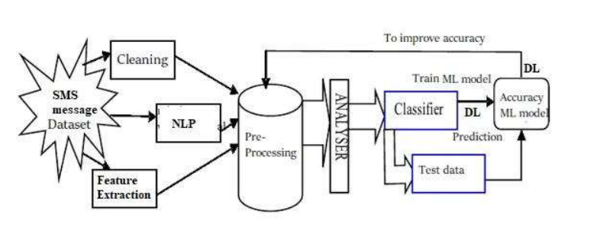
Architectural diagram

Slide 9
PROPOSED SYSTEM
In this project , going to implement Naïve Bayes algorithm to overcome the drawbacks of the existing system
NB Algorithm Performance: The Naive Bayes (NB) algorithm is applied to a dataset with varying training set sizes, and it demonstrates good overall accuracy in spam classification, particularly benefiting from the length of text messages as a significant feature.
Mutual Information (MI) identifies message length as the most informative feature and notes that some short text messages are misclassified as spam due to specific alphanumeric tokens.
The learning curve analysis indicates low variance, and to improve classifier performance, reducing bias through the addition of meaningful features to the token list is suggested.

Slide 10
ADVANTAGES
Complexity is less compared to previous process
Ability to learn and extract complex features.
Accuracy is good
With its simplicity and fast processing time, the proposed algorithm gives better execution time.
Both machine learning and deep learning technique is performed to predict the value effectively.
Prediction is accurate

Slide 11
MODULES
Module 1 - Data collection, cleaning and anonymization.
Module 2 - Data splitting, NLP, featurization.
Module 3- Splitting of data, Training data, testing data
Module 4 - modeling, performance evaluation

Slide 12
EXPECTED OUTCOME
The Naive Bayes (NB) algorithm demonstrates good overall accuracy in SMS spam classification, particularly benefiting from the informative feature of message length.
Mutual Information (MI) criteria highlight message length as the most valuable feature, while misclassification issues are noted for short text messages with specific alphanumeric tokens.
Learning curve analysis suggests that additional data may not significantly improve the algorithm's performance, indicating low variance but potential bias issues.
To enhance classifier performance, the project aims to reduce bias by adding more meaningful features to the token list used for classification.

Slide 13
REFERENCE
[1] Modupe, A., O. O. Olugbara, and S. O. Ojo. (2014) ―Filtering of Mobile Short Messaging Communication Using Latent Dirichlet Allocation with Social Network Analysis‖, in Transactions on Engineering Technologies: Special Volume of the World Congress on Engineering 2013, G.-C. Yang, S.-I. Ao, and L. Gelman, Eds. Springer Science & Business. pp. 671–686.
[2] Shirani-Mehr, H. (2013) ―SMS Spam Detection using Machine Learning Approach. p. 4.
[3] Abdulhamid, S. M. et al., (2017) ―A Review on Mobile SMS Spam Filtering Techniques. IEEE Access 5: 15650–15666.
[4] Aski, A. S., and N. K. Sourati. (2016) ―Proposed Efficient Algorithm to Filter Spam Using Machine Learning Techniques.‖ Pac. Sci. Rev. Nat. Sci. Eng. 18 (2):145–149.
[5] Narayan, A., and P. Saxena. (2013) ―The Curse of 140 Characters: Evaluating The Efficacy of SMS Spam Detection on Android.‖ p. 33– 42.
[6] Almeida, T. A., J. M. Gómez, and A. Yamakami. (2011) ―Contributions to the Study of SMS Spam Filtering: New Collection and Results.‖ p. 4.
[7] Mujtaba, D. G., and M. Yasin. (2014) ―SMS Spam Detection Using Simple Message
Content Features.‖ J. Basic Appl. Sci. Res. 4 (4): 5.

Slide 14
REFERENCE
[8] Gudkova, D., M. Vergelis, T. Shcherbakova, and N. Demidova. (2017) ―Spam and Phishing in Q3 2017.‖ Securelist - Kaspersky Lab‘s Cyberthreat Research and Reports. Available from: https://securelist.com/spam-and-phishing-in-q3-2017/82901/. [Accessed: 10th April 2018].
[9] Choudhary, N., and A. K. Jain. (2017) ―Towards Filtering of SMS Spam Messages Using Machine Learning Based Technique‖, in Advanced Informatics for Computing Research 712: 18-30.
[10] Safie, W., N.N.A. Sjarif, N.F.M. Azmi, S.S. Yuhaniz, R.C. Mohd, and S.Y. Yusof. (2018) ―SMS Spam Classification using Vector Space Model and Artificial Neural Network.‖ International Journal of Advances in Soft Computing & Its Applications 10 (3): 129-141.
[11] Fawagreh, Khaled, Mohamed Medhat Gaber, and Eyad Elyan. (2014) ―Random Forests: From Early Developments to Recent Advancements, Systems Science & Control Engineering.‖ An Open Access Journal 2 (1): 602-609.
[12] Sajedi, H., G. Z. Parast, and F. Akbari. (2016) ―SMS Spam Filtering Using Machine Learning Techniques: A Survey.‖ Machine Learning, 1 (1): 14.
[13] Q. Xu, E., W. Xiang, Q. Yang, J. Du, and J. Zhong. (2012) ―SMS Spam Detection Using Noncontent Features.‖ IEEE Intell. Syst. 27(6): 44–51.
[14] Sethi, G., and V. Bhootna. (2014) SMS Spam Filtering Application Using Android.
[15] Nagwani, N. K. (2017) ―A Bi-Level Text Classification Approach for SMS Spam Filtering and Identifying Priority Messages.‖ 14 (4): 8.

Slide 15
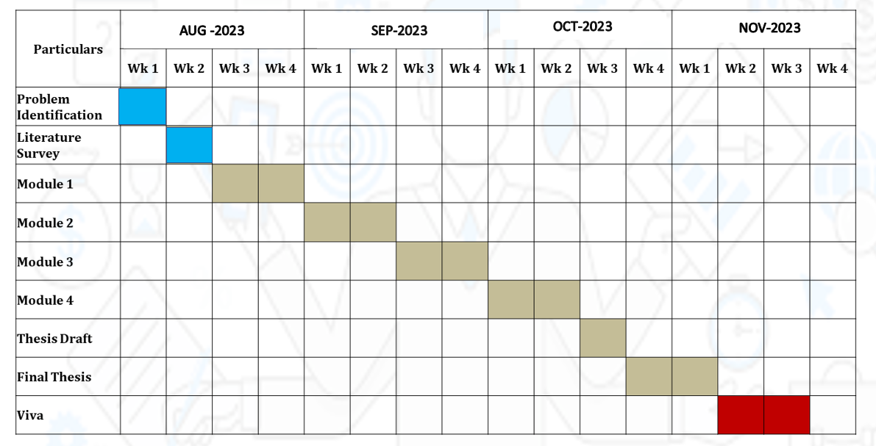
TIMELINE

Slide 16
THANK YOU

